Slide 1
TOKYO VS TORONTO
CAPSTONE PROJECT

Slide 2
INTRODUCTION
First I would like to give you a little detail about the project we are supposed to discuss here. In this project I will be designing a business friendly report help a client to make their decision thou this report will be purely based on the studies I make in the whole process of analyzing the open source data.

Slide 3
BUSINESS PROBLEM
In this project I will be lighting a specific area for the business startup gigs to make their business successful. In this project I would like to know the field of my client business and I will provide them statics prove that are required to make my report of this machine learning look authentic. In other words I will help make their decision and provide a business model just for the location at least in the starting of this deal.

Slide 4
DATA
The data is essential for any machine learning model. This is important that data is valuable because with wrong data the model predict wrong values so this is very important for us to take data from the good source.
For my project I have decided to use foursquare because it will be produce best result that for the type of my project and it would be beneficial for my client as well.

Slide 5
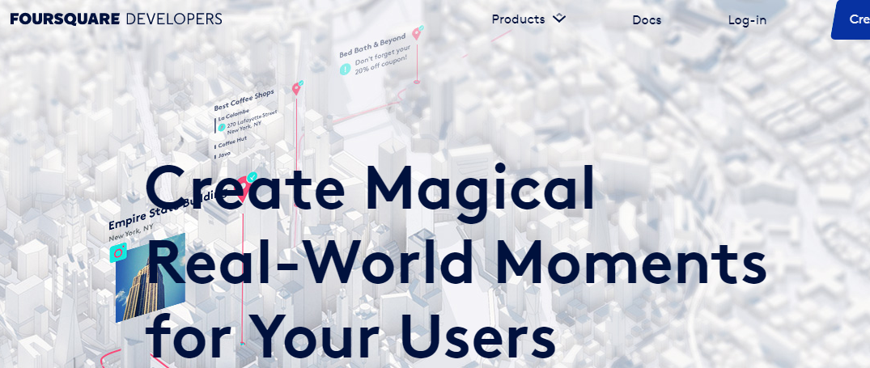
Foursquare developer portal

Slide 6
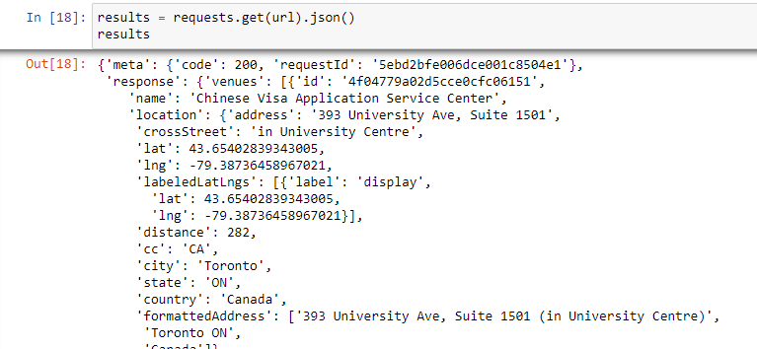
JSON FILE ‘R’

Slide 7
DATA FRAME
From this json file I will exact the information about the Chinese restaurants and hotel because my client wants to open a Chinese venue in one of the cities. The data frame is shown below;

Slide 8
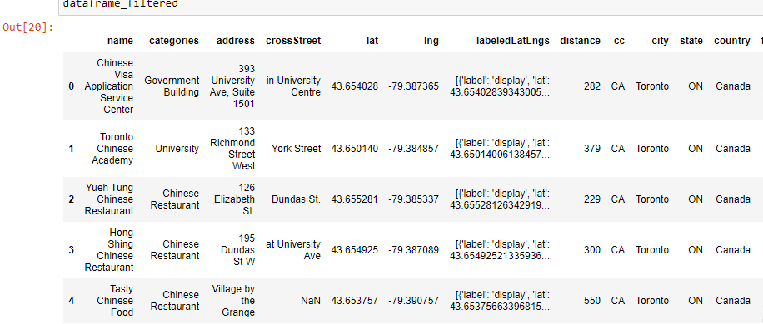

Slide 9
METHODOLOGY
In this case study the client wants to open a restaurant. The client is certain about the cuisine which is Chinese and the owner is giving me the space of choosing between two cities Toronto and Tokyo. The client want me to use data science whether to determine which one of these places are good for Chinese food business

Slide 10
APPROACH
The approach determined by me for this task is to use folium libraries and I will plot the location of all Chinese restaurants in the area of busy Toronto and Tokyo and predict a spot for the restaurant to do business good and avoid any loss by making any bad decision.

Slide 11
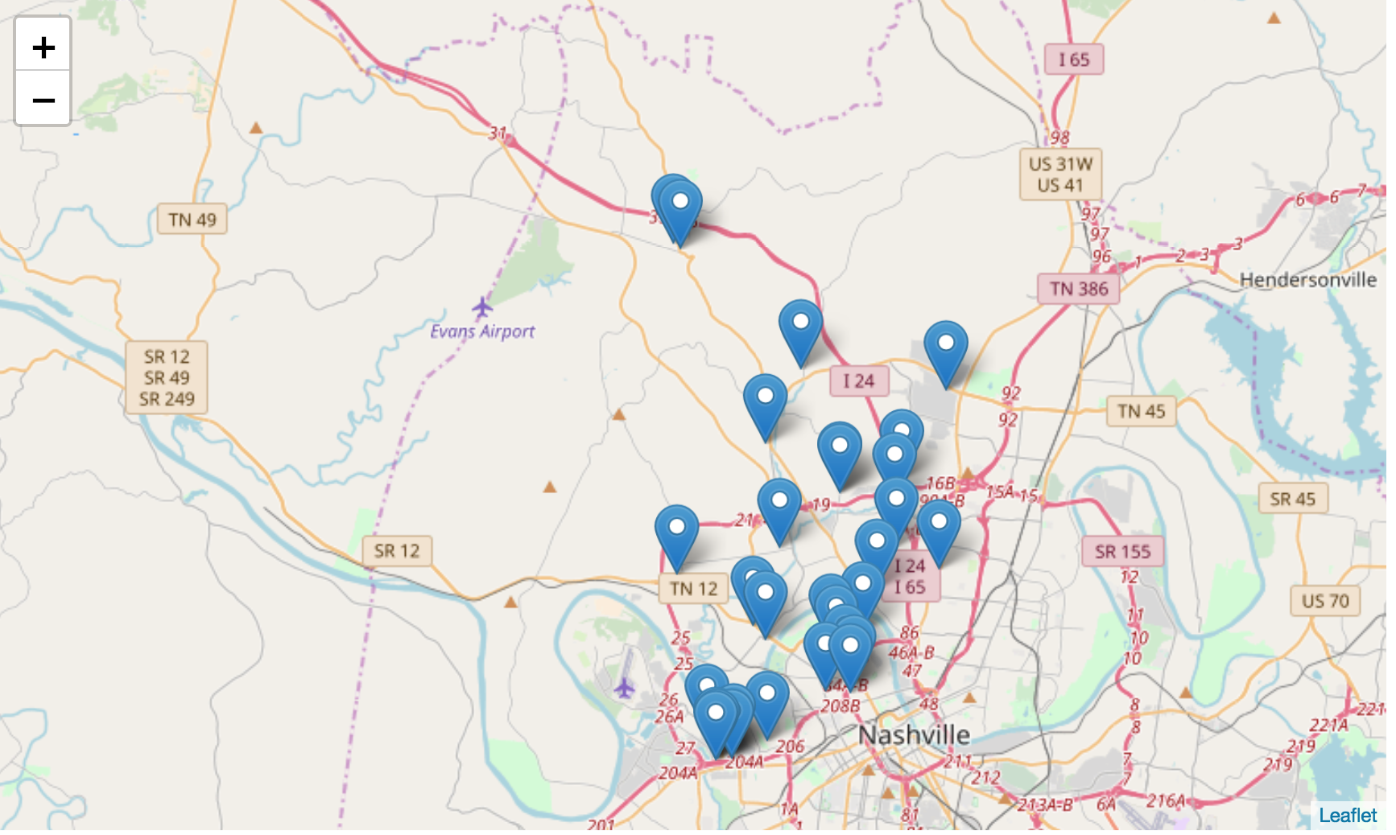

Slide 12
RESULTS
The output will show the result from the folium which will help us make the decision for the location.

Slide 13
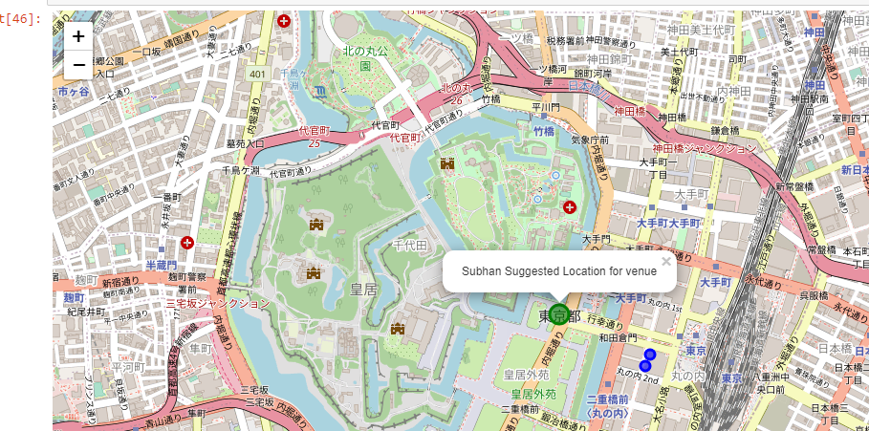
Firstly I will display the result which was extracted from Tokyo;

Slide 14
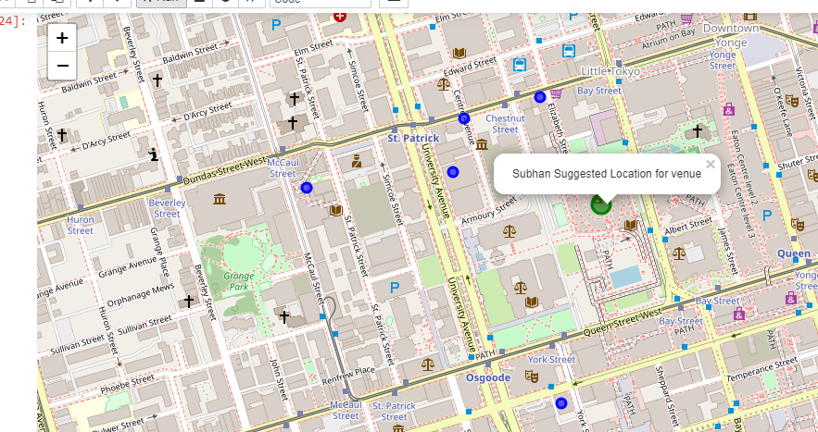
Secondly I will display the result which was extracted from Toronto;

Slide 15
In the result from Tokyo there are fewer Chinese venues in the area represented in the blue spot which yields the fact of low demand of Chinese food in the area Thus, opening a restaurant on the green spot “ Subhan Suggested Location for venue ”. Where else in case of Toronto there are many more restaurant showing more demand for Chinese food in the area. Thus, it is more likely to get better business in Toronto green spotted location suggested by the machine learning algorithm.

Slide 16
DISCUSSION SECTION
I have made a lot of learning in this capstone project. There may be many more ways to comprehend the studies and use data to accomplish the model to predict the result to make better decision for your clients.

Slide 17
CONCLUSION
From the approach used in this project we are able to say that there is no better way in the future to make decision for your startups and for the big data and it analysis is something so big that will make this field of study from strong and comprehend for the future events that are going to come across the path in the near future.

